Slide 1
Goals for today
Climate in “recent” times
Pleistocene (back 3 million years)
Holocene (starting 10,000 years ago)
Anthropocene (beginning in last 150 years)
Some historical perspectives
Eunice Foote, mid-1800s: how the greenhouse effect works
Svante Arrhenius, early 1900s: how the greenhouse effect could be a good thing
Importance of Polar Amplification (NASA scientists, Francis & Vavrus and others)

Slide 2
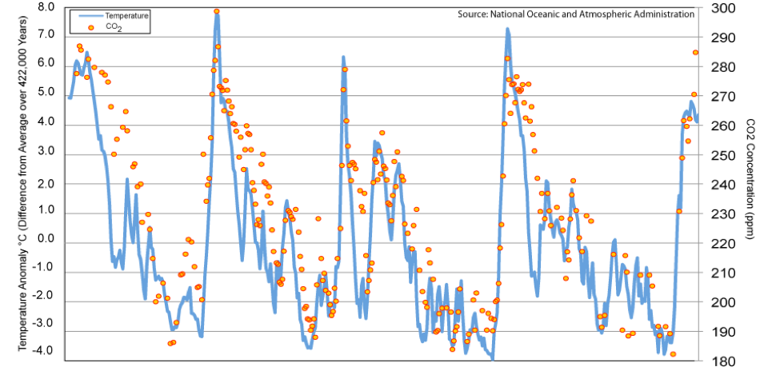
Pleistocene
Pleistocene
(back 3 million years)
400,000 years ago -------> Present
Notes:
Predict the temperature if CO2 continues to rise. If we reduce CO2 emissions to zero.

Slide 3
Pleistocene
The Blue markers show the correlation between global temperature and atmospheric CO₂ in the Pleistocene.
Notes:
Predict the temperature if CO2 continues to rise. If we reduce CO2 emissions to zero.

Slide 4
Pleistocene
Pleistocene
(back 3 million years)
400,000 years ago -------> Present
Notes:
Predict the temperature if CO2 continues to rise. If we reduce CO2 emissions to zero.

Slide 5
Holocene
Holocene
(last 10,000 years)
400,000 years ago -------> Present
Notes:
Predict the temperature if CO2 continues to rise. If we reduce CO2 emissions to zero.

Slide 6
Anthropocene (post-industrial period, beginning in last 150 years)
Last 150 years
Arctic
Global
Arctic
Global
400,000 years ago -------> Present
Notes:
Predict the temperature if CO2 continues to rise. If we reduce CO2 emissions to zero.

Slide 7
The 4x difference between global and polar trends in the last 150 years is part of what’s called Polar Amplification
The orange markers show the correlation between global temperature and atmospheric CO₂ in the last 150 years.
The green markers show the correlation between Arctic temperatures and atmospheric CO₂ in the last 150 years..
Notes:
Predict the temperature if CO2 continues to rise. If we reduce CO2 emissions to zero.

Slide 8
Goals for today
Climate in “recent” times
Pleistocene (back 3 million years)
Holocene (starting 10,000 years ago)
Anthropocene (beginning in last 150 years)
Some historical perspectives
Eunice Foote, mid-1800s: how the greenhouse effect works
Svante Arrhenius, early 1900s: how the greenhouse effect could be a good thing
Importance of Polar Amplification (NASA scientists, Francis & Vavrus and others)

Slide 9
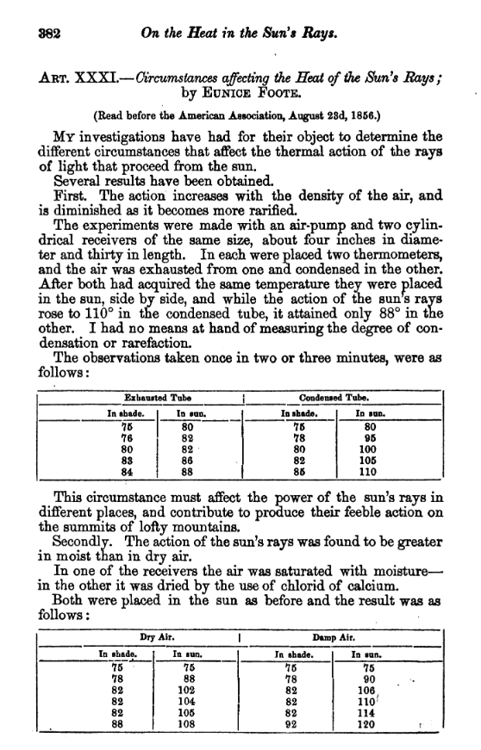
Eunice Foote, 1856
Experiments with “an air-pump and two cylindrical receivers” found the warming effect of the sun to be
“greater in moist than dry air” (H₂O)
“highest … in carbonic acid gas” (CO₂)
“An atmosphere of that gas would give to our earth a high temperature.”
Notes:
Foote was an American scientist and women’s rights campaigner. She was on the editorial committee of the first women’s rights convention in 1848 and a friend and neighbor of suffragist Elizabeth Cady Stanton. Her work was presented by a man and excluded from the published proceedings. Summaries that were published omitted her conclusions about the impact of carbon dioxide on climate. One publication misrefers to her husband. A later scientist, John Tyndall, was apparently unaware of her work and did not credit her.

Slide 10
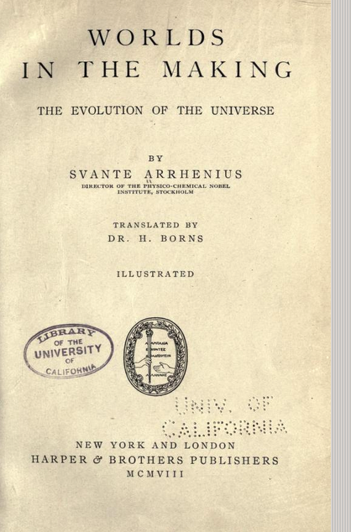
Svante Arrhenius, 1909
“Any doubling of the percentage of carbon dioxide in the air would raise the temperature of the earth’s surface by 4°”
“The enormous combustion of coal by our industrial establishments suffices to increase the percentage of carbon dioxide in the air to a perceptible degree.”
Notes:
Foote was an American scientist and women’s rights campaigner. She was on the editorial committee of the first women’s rights convention in 1848 and a friend and neighbor of suffragist Elizabeth Cady Stanton. Her work was presented by a man and excluded from the published proceedings. Summaries that were published omitted her conclusions about the impact of carbon dioxide on climate. One publication misrefers to her husband. A later scientist, John Tyndall, was apparently unaware of her work and did not credit her.

Slide 11
Svante Arrhenius, 1909
By increasing CO₂ “…in the atmosphere, we may hope to enjoy ages with more equable and better climates, especially as regards the colder regions of the earth, ages when the earth will bring forth much more abundant crops than at present, for the benefit of a rapidly propagating mankind.”
Notes:
Foote was an American scientist and women’s rights campaigner. She was on the editorial committee of the first women’s rights convention in 1848 and a friend and neighbor of suffragist Elizabeth Cady Stanton. Her work was presented by a man and excluded from the published proceedings. Summaries that were published omitted her conclusions about the impact of carbon dioxide on climate. One publication misrefers to her husband. A later scientist, John Tyndall, was apparently unaware of her work and did not credit her.

Slide 12
Goals for today
Climate in “recent” times
Pleistocene (back 3 million years)
Holocene (starting 10,000 years ago)
Anthropocene (beginning in last 150 years)
Some historical perspectives
Eunice Foote, mid-1800s: how the greenhouse effect works
Svante Arrhenius, early 1900s: how the greenhouse effect could be a good thing
Importance of Polar Amplification (NASA scientists, Francis & Vavrus and others)

Slide 13
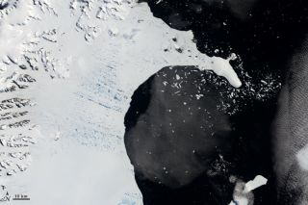
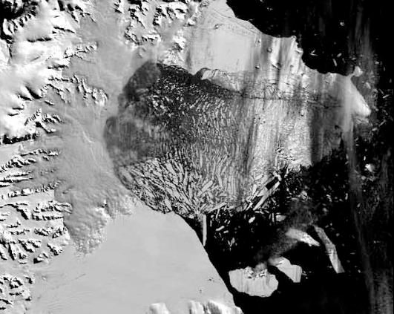
Ice and snow reflect sunlight, so when they melt (or disintegrate), the sunlight warms the land and ocean.
NASA scientists, 2002
January 31, 2002
March 5, 2002
Courtesy of NASA
Photos taken of the Larsen-B ice shelf in the Antarctic Peninsula. Courtesy of NASA
Notes:
Ice in greenland nearly vanishing after a few months

Slide 14
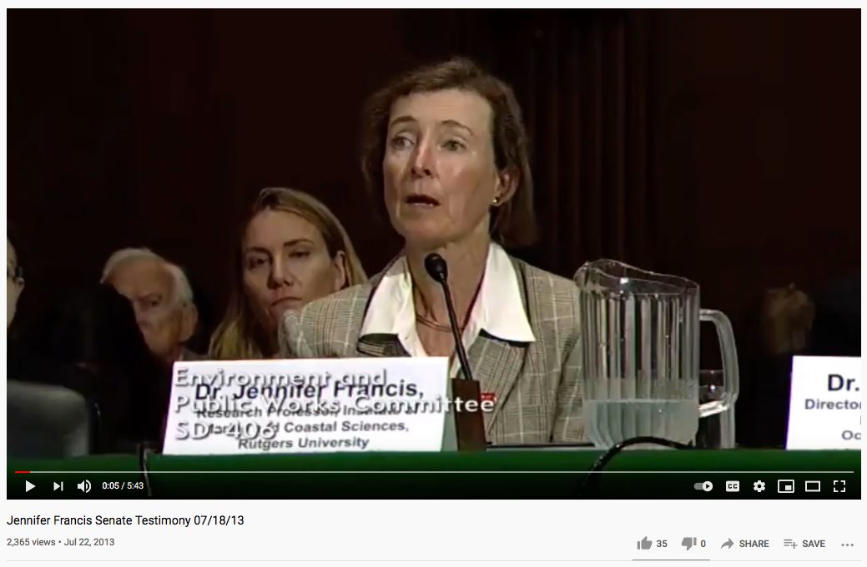
Francis and Vavrus, 2013
https://www.youtube.com/watch?v=8eyNm2QcOw8&feature=youtu.be

Slide 15
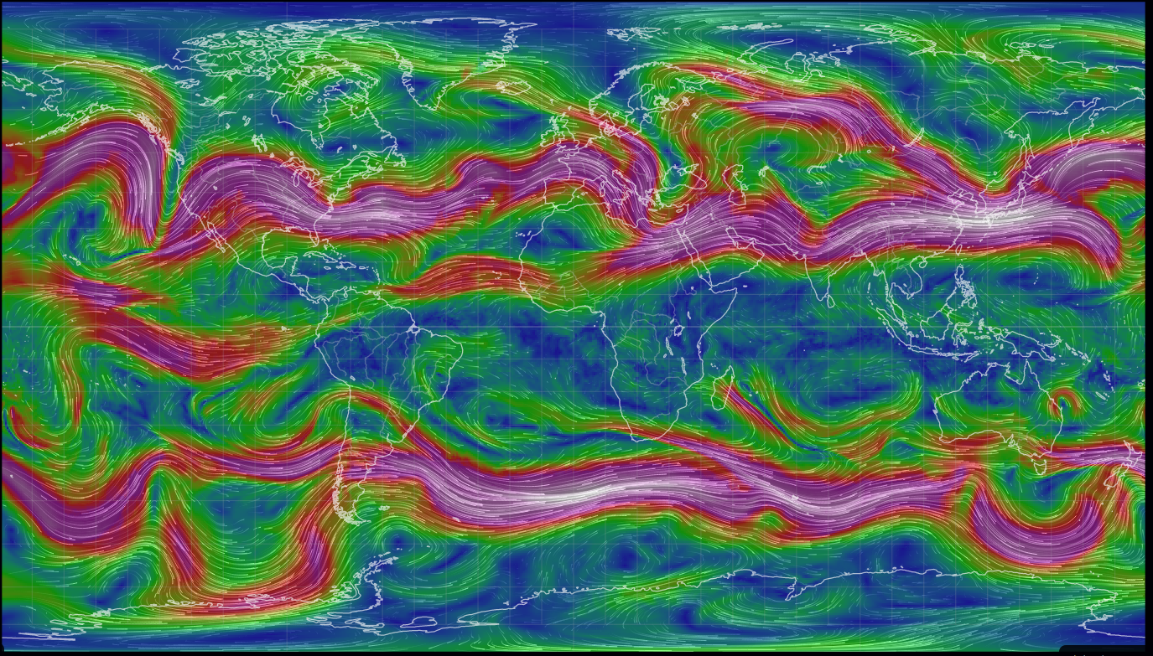
Jet stream forms a meandering boundary between cold Polar air and warmer mid-latitude air
Cold Arctic air
Warm mid-latitude air
Cold Antarctic air

Slide 16
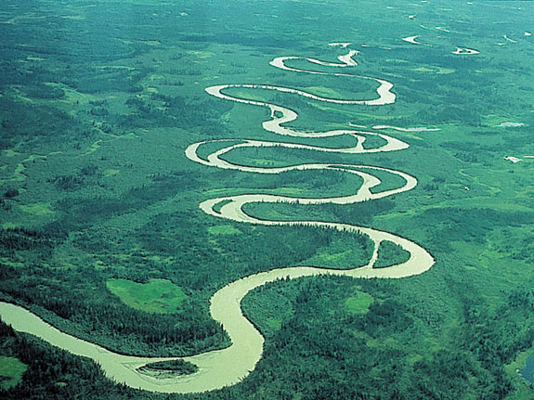
But meandering happens more when the terrain is flat

Slide 17
Warmer Arctic -> less temperature difference between Arctic and mid-latitude -> jet is wavier and slower
Cold Arctic air
Warm mid-latitude air
Cold Antarctic air

Slide 18
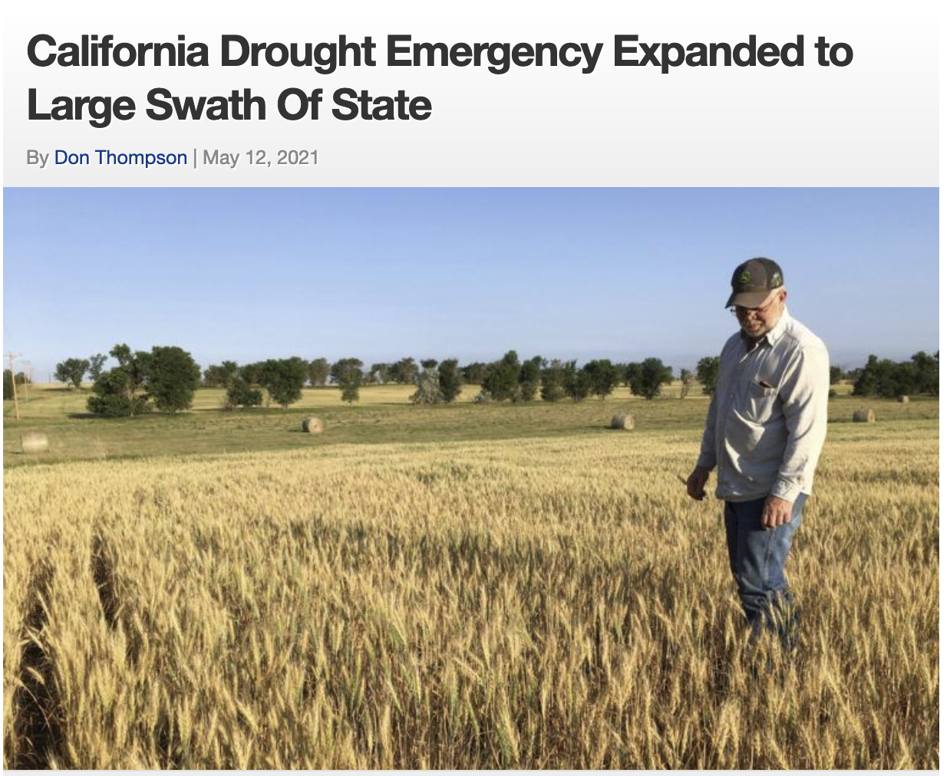
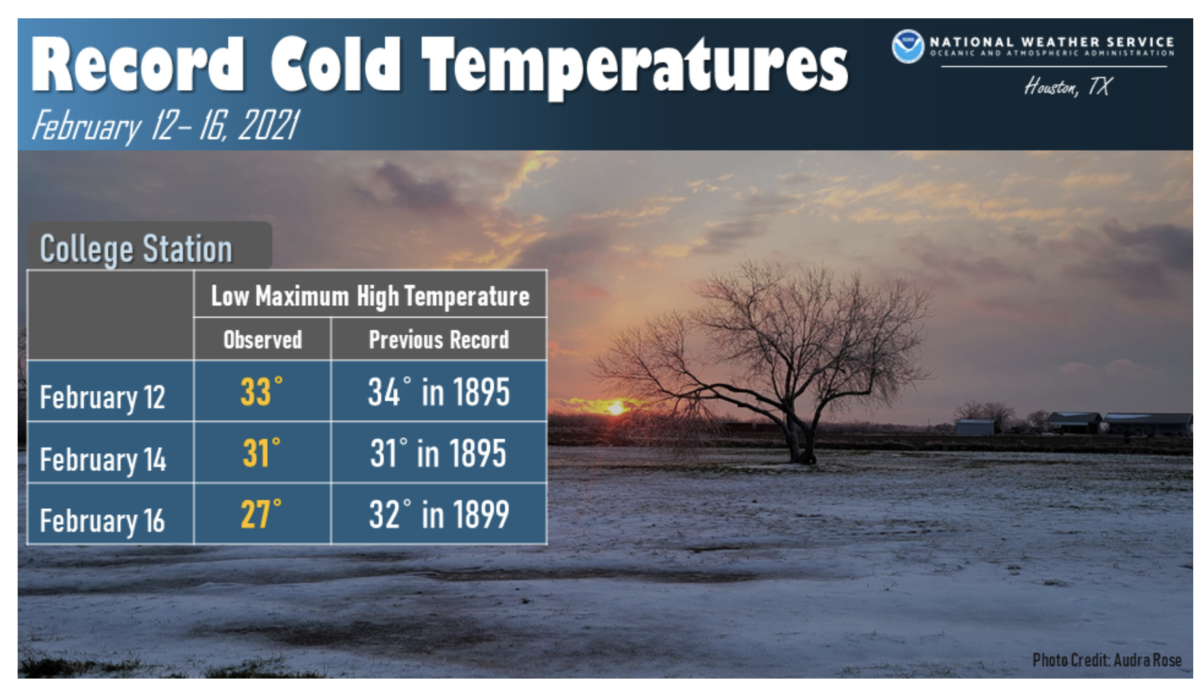

Warmer Arctic -> less temperature difference between Arctic and mid-latitude -> jet is wavier and slower -> prolonged periods of drought and cold

Slide 19

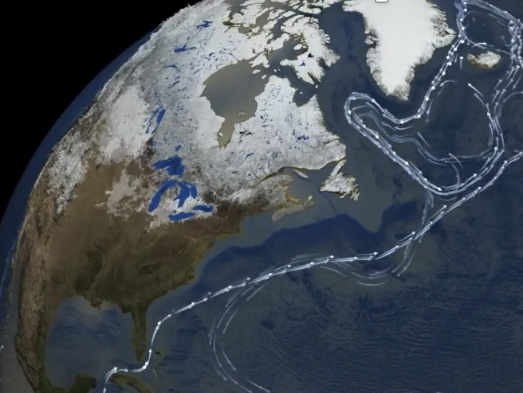
The AMOC as a key climate regulator (because it moves heat around the globe)
https://www.youtube.com/watch?v=jOVvXDI0KbY

Slide 20
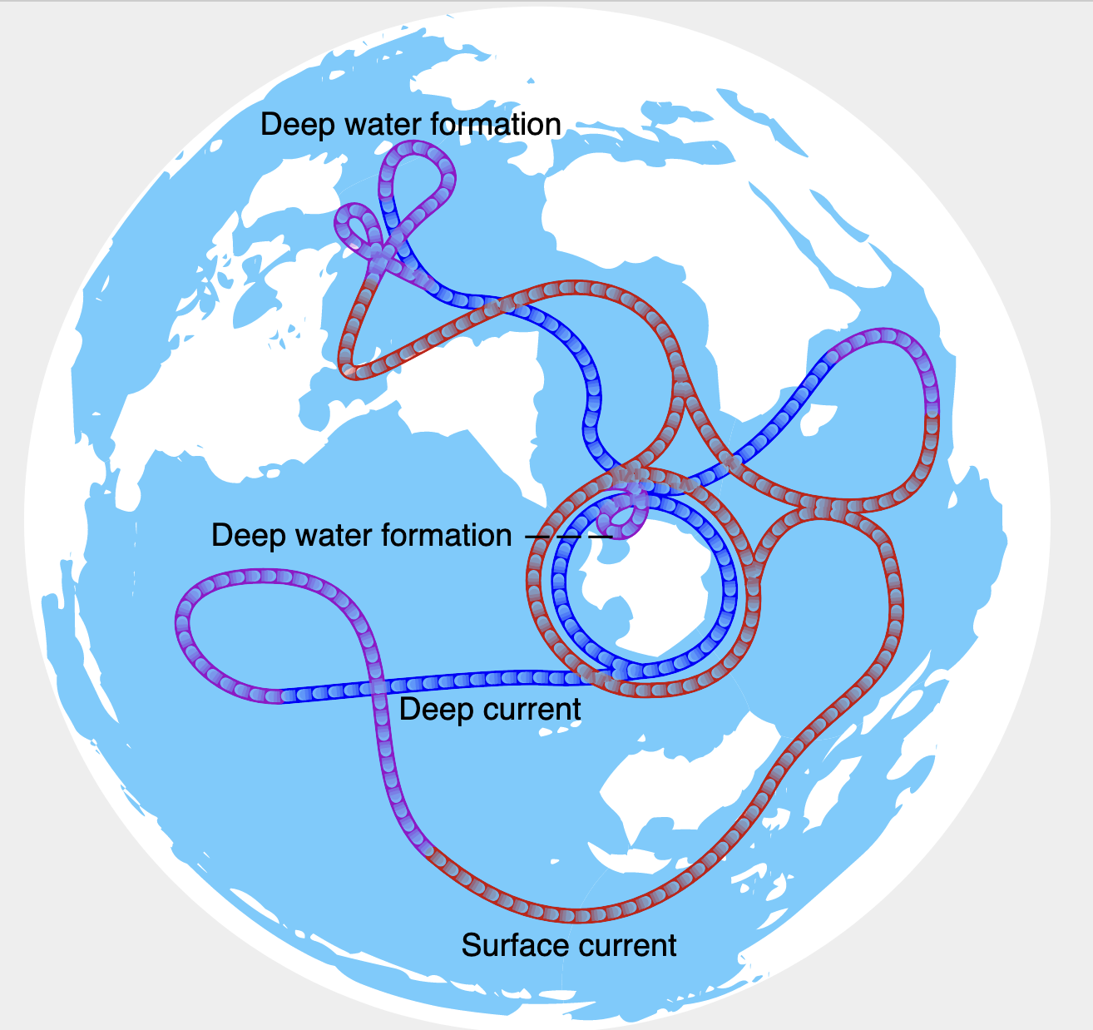
AMOC’s role in pushing water away from the eastern coast of N. America
https://upload.wikimedia.org/wikipedia/commons/a/ab/Thermohaline_circulation.svg

Slide 21
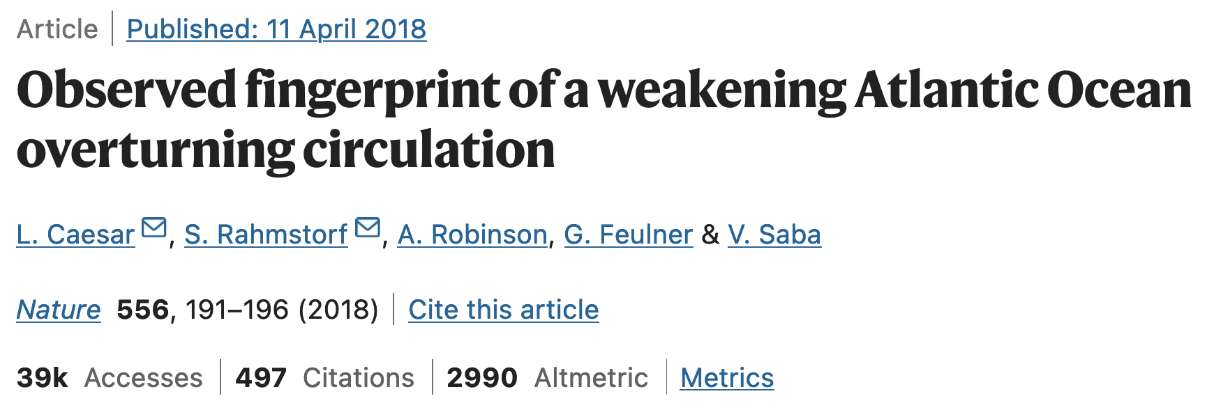
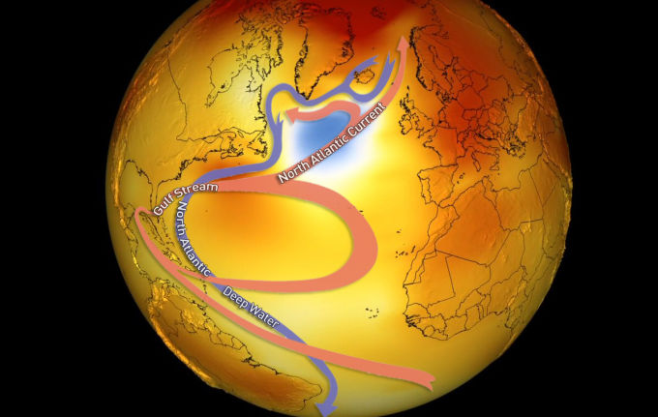
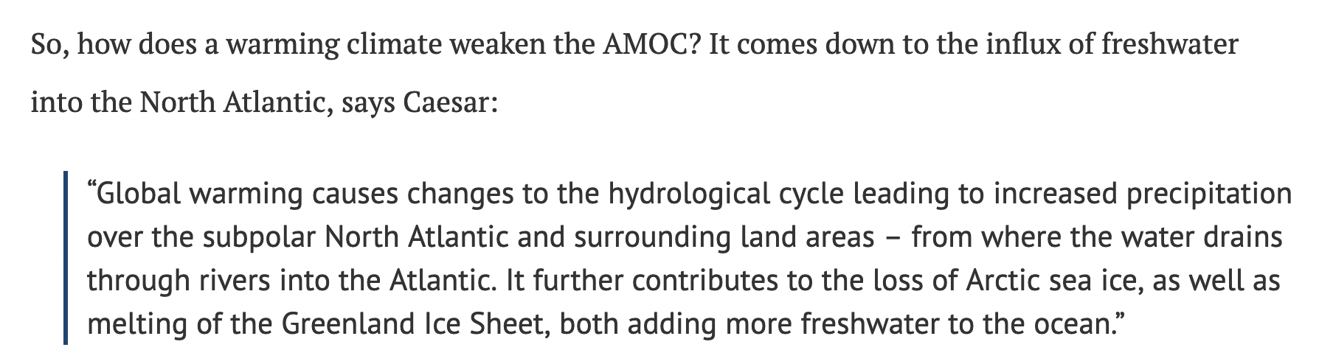
But warming is causing the AMOC to slow down (via the “cold blob”)
https://www.carbonbrief.org/atlantic-conveyor-belt-has-slowed-15-per-cent-since-mid-twentieth-century/

Slide 22
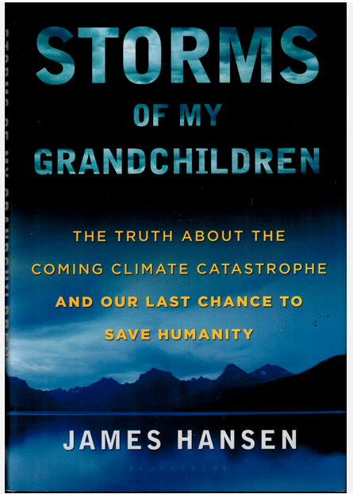
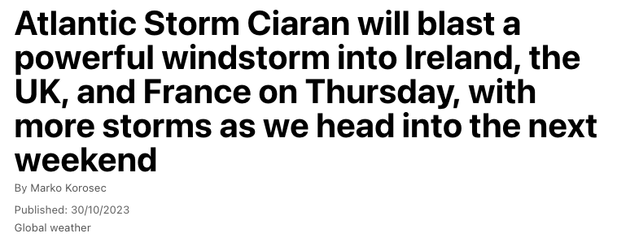
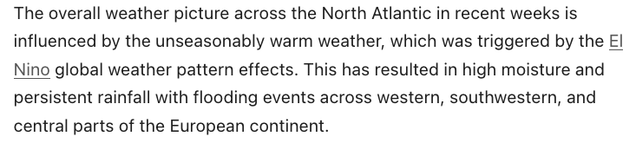
Why we care: For one, a slower AMOC would lead to ferocious storms in the N. Atlantic

Slide 23
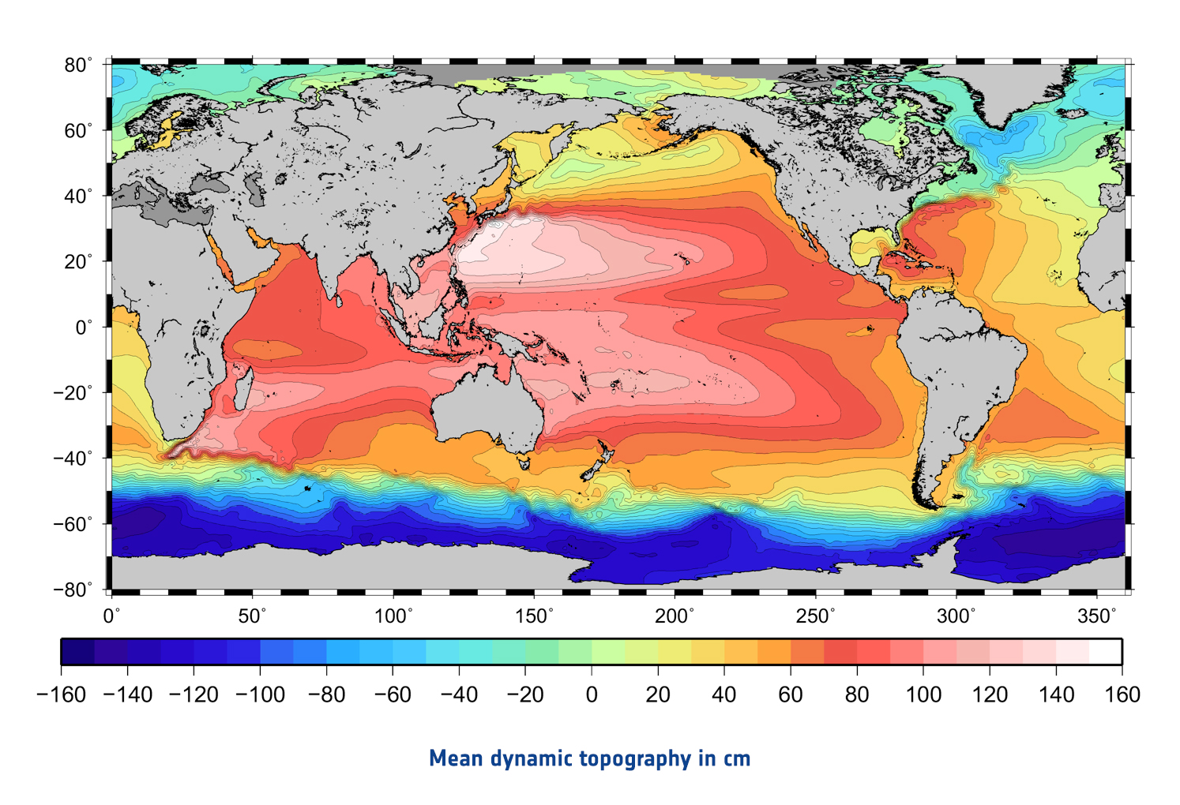
Why we care #2: AMOC pushes sea water away from eastern US coast
https://www.esa.int/ESA_Multimedia/Images/2014/11/Mean_dynamic_topography

